Slide 1
Regression Analysis
Notes:
This week we’re discussing regression analysis.

Slide 2
What is regression?
In the frequentist view, the regression of a variable Y on another variable X is the function that describes how the average (mean) value of Y changes across population subgroups defined by values of X (Greenland, 2008, pg.382).
So, what does that mean?
Regression Function:
E(Y|X=x)
The average of Y when the variable X takes on the specific value x.
“E” stands for expectation, which here is just another word for population mean.
Sex and Diabetes Example
Notes:
-E(Y|X=x):
-Y is the dependent variable, outcome variable, or regressand
-X is the independent variable, predictor variable, covariate, or regressor
-Dependent / Independent should not imply causation.
-”Regression analysis is helpful in assessing specific forms of the relationship between variables, and the ultimate objective when this method of analysis is employed usually is to predict or estimate the value of one variable corresponding to a given value of another variable.” (Daniel, 2005, pg. 410)

Slide 3
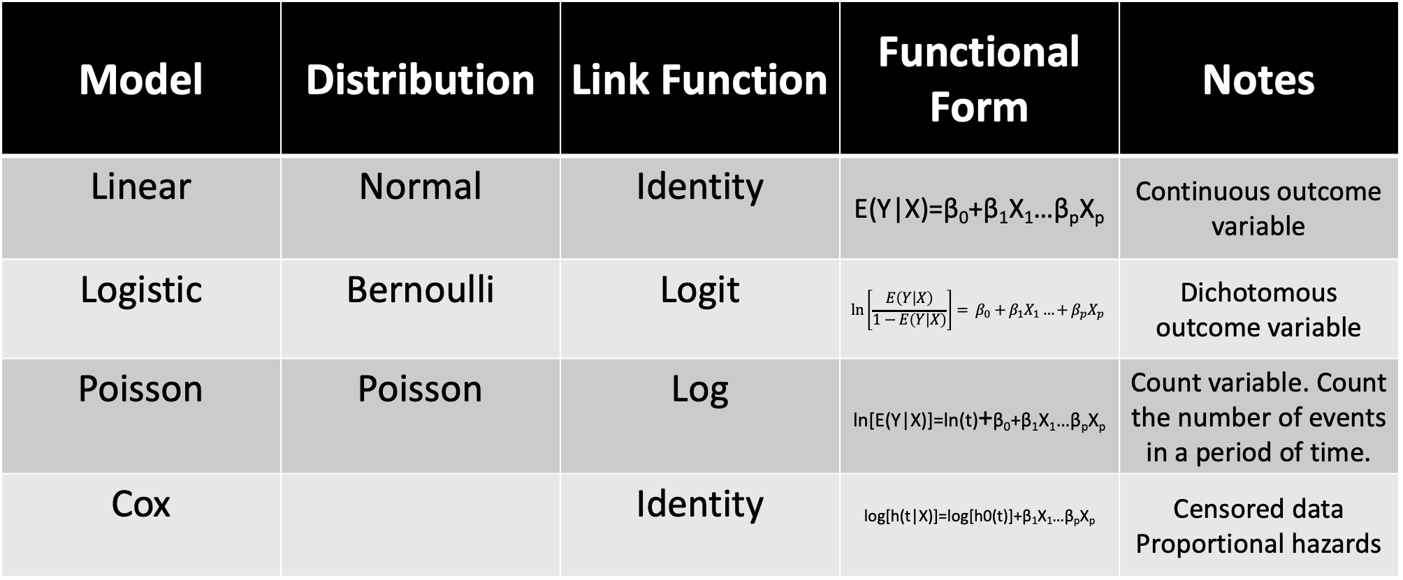
Model | Distribution | Link Function | Functional Form | Notes
Linear | Normal | Identity | E(Y|X)=β₀+β₁X₁…β_{p}X_{p} | Continuous outcome variable
Logistic | Bernoulli | Logit | $$\ln\left[\frac{E\left(Y | X\right)}{1−E\left(Y | X\right)}\right]= β_{0}+β_{1}X_{1}…+β_{p}X_{p}$$ | Dichotomous outcome variable
Poisson | Poisson | Log | ln[E(Y|X)]=ln(t)+β₀+β₁X₁…β_{p}X_{p} | Count variable. Count the number of events in a period of time.
Cox |  | Identity | log[h(t|X)]=log[h0(t)]+β₁X₁…β_{p}X_{p} | Censored data Proportional hazards
Notes:
Types of regression we cover in this course.
-First, choose an outcome variable. Then, look at its distribution. Choose a model based on that.
-I’m not going to spend a lot of time going over the basic nuts and bolts of regression. If you are in this class you should have already had some exposure to basic regression concepts. However, I will quickly review a couple of things and give you some tables that we can refer back to as we move through this lecture.
- The Cox proportional hazards model is called a semi-parametric model, because there are no assumptions about the shape of the baseline hazard function. There are however, other assumptions as noted above (i.e., independence, changes in predictors produce proportional changes in the hazard regardless of time, and a linear association between the natural logarithm of the relative hazard and the predictors). There are other regression models used in survival analysis that assume specific distributions for the survival times such as the exponential, Weibull, Gompertz and log-normal distributions

Slide 4
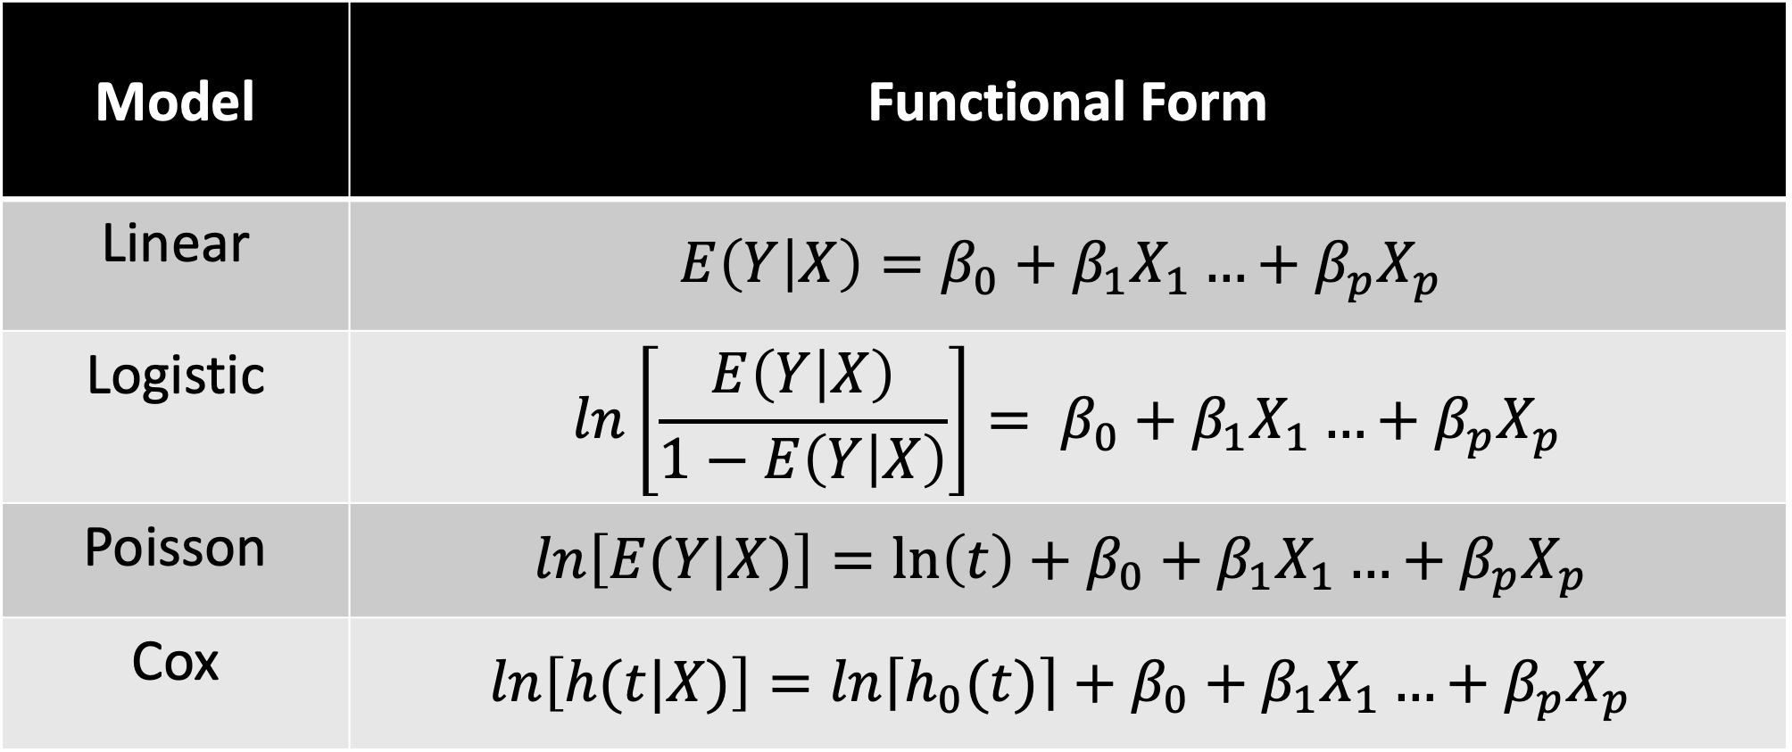
Model | Functional Form
Linear | $$E\left(Y | X\right)=β_{0}+β_{1}X_{1}…+β_{p}X_{p}$$
Logistic | $$\ln\left[\frac{E\left(Y | X\right)}{1−E\left(Y | X\right)}\right]= β_{0}+β_{1}X_{1}…+β_{p}X_{p}$$
Poisson | $$ln\left[E(Y|X)\right]=\ln\left(t\right)+β_{0}+β_{1}X_{1}…+β_{p}X_{p}$$
Cox | $$ln\left[h(t|X)\right]=ln\left\lceil h_{0}(t)\right\rceil +β_{0}+β_{1}X_{1}…+β_{p}X_{p}$$
Notes:
A close up of the functional forms.
Linear combination of predictors. Generalized linear models.
Next, we’ll go over some examples. The goal isn’t to teach you how to code in Stata and R. Rather, the goal is to teach you to be able to read output from Stata and R. I’m not using both to confuse you. I’m using both because someday soon the course (and possibly the entire epi curriculum) will use both. Also, I think it’s helpful to be able to find the information you are looking for without being to dependent on the way one particular statistical program presents it to you.
Note that these formulas can be rearranged in many different ways. Don’t get alarmed if they look different in different places.

Slide 5
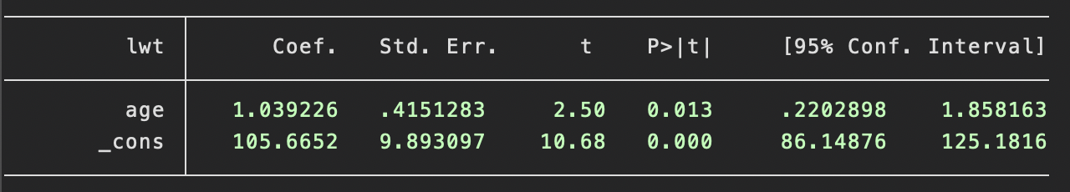
Regress mother's weight on age
{Stata}
regress lwt age
Notes:
We’ll start by regressing mother’s weight on mother’s age.
To be consistent with Dr. Lee, I will present the code in blue. Again, you don’t need to know the code. It’s just there in case you are interested.
What type of regression model did we we fit here? linear
Intercept: The value of Y when all X are equal to zero.
Coefficients: The change in Y for each one-unit change in x.
Interpret intercept: The expected (average) value of mother’s weight is 105.67 pounds when mother’s age is equal to zero.
Interpret age coefficient: The average increase in mother’s weight is 1.04 pounds for each one-year increase in mother’s age.

Slide 6
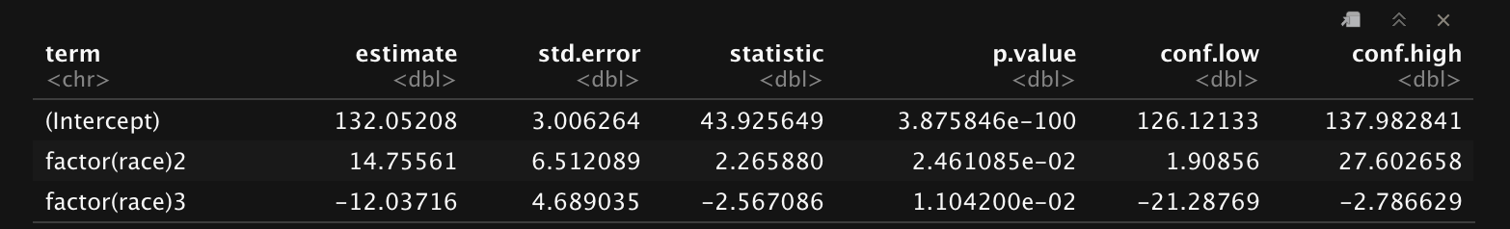
Regress mother's weight on race
{R}
lm1 <- lm(lwt ~ factor(race), data = lowbt)
tidy(lm1, conf.int = TRUE)
* Race can take the values 1, 2 or 3
Notes:
Reference level: 1
Interpret intercept: The average value of mother’s weight is 132.05 pounds when mother’s race is equal to 1.
Interpret race 2 coefficient: Mother’s weight is 14.76 pounds higher, on average, for mother’s with race 2 compared to mother’s with race 1.

Slide 7
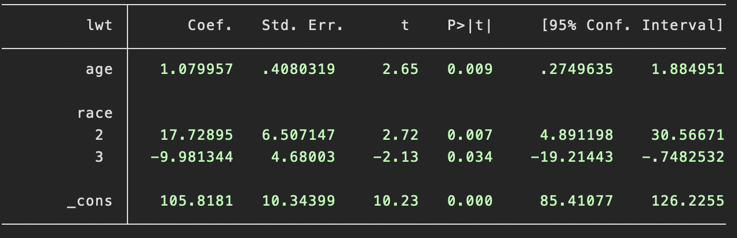
Regress mother's weight on age and race
{Stata}
regress lwt age i.race
* Race can take the values 1, 2 or 3
Notes:
Reference level: 1
Interpret intercept: The average value of mother’s weight is 105.82 pounds when mother’s age is equal to zero and mother’s race is equal to one.
Interpret age coefficient: The average increase in mother’s weight is 1.08 pounds for each one-year increase in mother’s age, holding race constant.
Interpret race 3 coefficient: Mother’s weight is 9.98 pounds lower, on average, for mother’s with race 3 compared to mother’s with race 1, holding age constant.

Slide 8
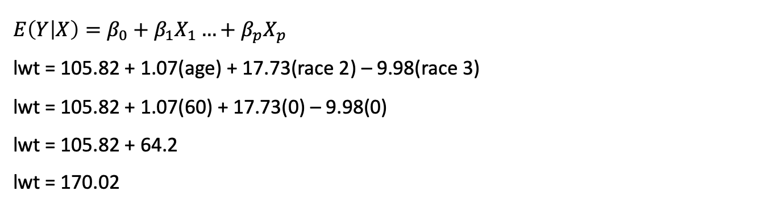
Predict the weight of a mother who is age 60 and race 1
$$E\left(Y | X\right)=β_{0}+β_{1}X_{1}…+β_{p}X_{p}$$
lwt = 105.82 + 1.07(age) + 17.73(race 2) – 9.98(race 3)
lwt = 105.82 + 1.07(60) + 17.73(0) – 9.98(0)
lwt = 105.82 + 64.2
lwt = 170.02
Notes:
Now, let’s use our fitted model to do a little prediction.

Slide 9
Linear regression assumptions
εi ~ i.i.d.N(0,σ2) is the error term
Normal distribution
Mean zero
Constant variance
εi and εj are statistically independent if i ≠ j
LINE (Linear, Independent, Normal, Equal Variance)
Notes:
Here are some assumptions about the residuals to keep in mind.

Slide 10
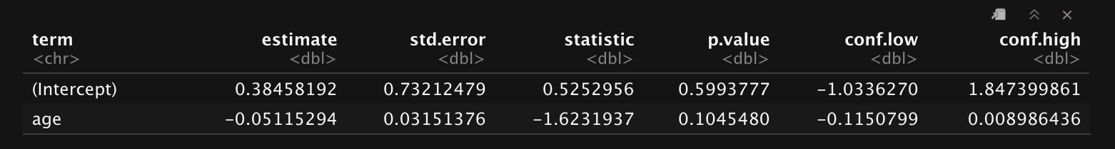
Regress low birth weight on mother's age (continuous predictor)
{R}
logistic1 <- glm(low ~ age, family = "binomial", data = lowbt)
tidy(logistic1, conf.int = TRUE)
Notes:
Now what kind of model are we using? logistic
Interpret intercept: The log odds of low birth weight are 0.38 when age is equal to zero. However, we generally don’t interpret of a logistic regression model on its own.
Interpret age coefficient: The log odds of low birth weight decrease by -0.051, on average, for each 1-year increase in mother’s age.
How do we convert log odds to odds? Exponentiate.

Slide 11
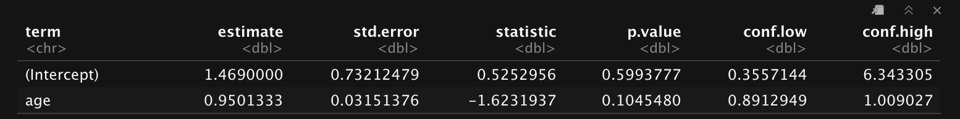
Regress low birth weight on mother's age (continuous predictor)
{R}
logistic1 <- glm(low ~ age, family = "binomial", data = lowbt)
tidy(logistic1, conf.int = TRUE, exponentiate = TRUE)
Notes:
Interpret intercept: We generally don’t interpret the intercept on its own in a logistic regression model.
Interpret age coefficient: For each 1-year increase in mother’s age, the odds of low birth weight decrease by 5%, on average.

Slide 12
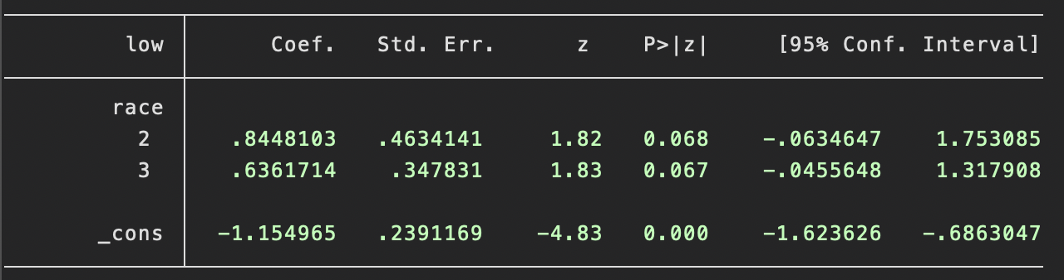
Regress low birth weight on mother's race (categorical predictor)
{Stata}
logit low i.race
* Race can take the values 1, 2 or 3
Notes:
Reference level: 1
Interpret intercept: We generally don’t interpret the intercept on its own in a logistic regression model.
Interpret race 2 coefficient: The log odds of low birth weight are 0.845 higher, on average, for mother’s with race 2 compared to mother’s with race 1.

Slide 13
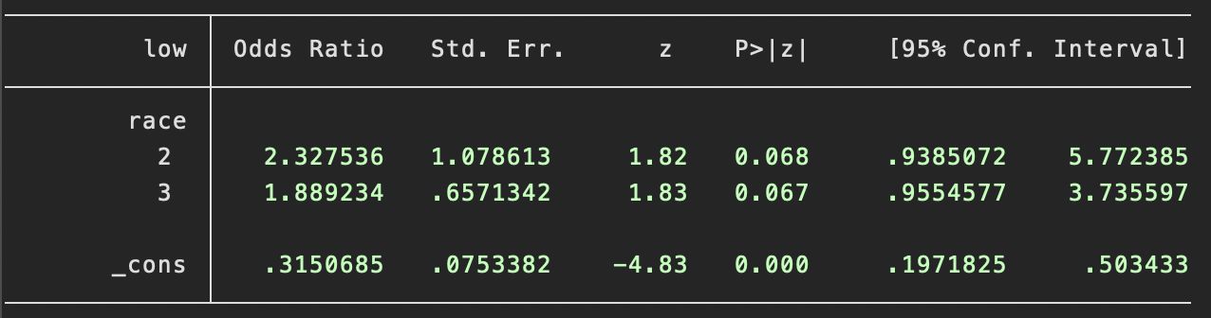
Regress low birth weight on mother's race (categorical predictor)
{Stata}
logit low i.race, or
* Race can take the values 1, 2 or 3
Notes:
Reference level: 1
Interpret intercept: We generally don’t interpret the intercept on its own in a logistic regression model.
Interpret race 2 coefficient: The odds of low birth weight for a baby whose mother is race 2 are 2.33 times that of a baby whose mother is race 1, on average.

Slide 14
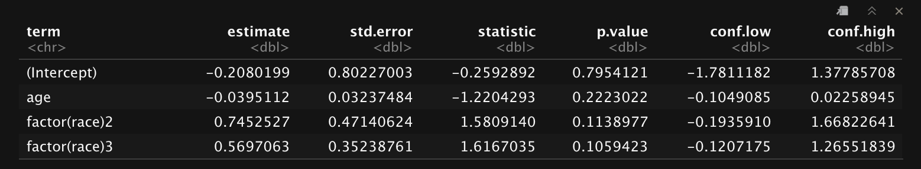
Regress low birth weight on mother's age and mother's race (multiple predictors)
{R}
logistic3 <- glm(low ~ age + factor(race), family = "binomial", data = lowbt)
tidy(logistic3, conf.int = TRUE)
* Race can take the values 1, 2 or 3
Notes:
Reference level: 1
Interpret intercept: We generally don’t interpret the intercept on its own in a logistic regression model.
Interpret age coefficient: The log odds of low birth weight decrease by 0.04, on average, for each 1-year increase in mother’s age, holding race constant.
Interpret race 3 coefficient: The log odds of low birth weight for a baby whose mother is race 3 are 0.56 higher that of a baby whose mother is race 1, on average, holding age constant.

Slide 15
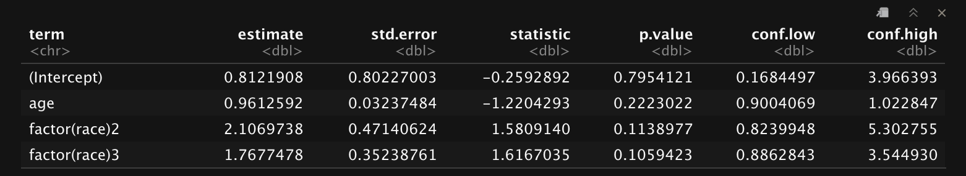
Regress low birth weight on mother's age and mother's race (multiple predictors)
{R}
logistic3 <- glm(low ~ age + factor(race), family = "binomial", data = lowbt)
tidy(logistic3, conf.int = TRUE, exponentiate = TRUE)
* Race can take the values 1, 2 or 3
Notes:
Reference level: 1
Interpret intercept: We generally don’t interpret the intercept on its own in a logistic regression model.
Interpret age coefficient: For each 1-year increase in mother’s age, the odds of low birth weight decrease by 4%, on average, holding race constant.
Interpret race 3 coefficient: The odds of low birth weight for a baby whose mother is race 3 are 1.76 that of a baby whose mother is race 1, on average, holding age constant.

Slide 16
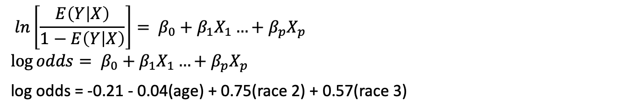
Write out the fitted model
$$\ln\left[\frac{E\left(Y | X\right)}{1−E\left(Y | X\right)}\right]= β_{0}+β_{1}X_{1}…+β_{p}X_{p}$$
$$\log{odds}= β_{0}+β_{1}X_{1}…+β_{p}X_{p}$$
log odds = -0.21 - 0.04(age) + 0.75(race 2) + 0.57(race 3)
Notes:
Here is what the fitted model looks like.

Slide 17
Logistic regression assumptions
The outcome Y follows a Bernoulli distribution with the mean determined by the logistic function
Observations are independent
The predictors are linearly related to the log odds of the outcome

